Slide 1

welcome

Slide 2

STOCK MATE CRM
Goods Stock and Business Analysis with Customer Relationship Management Software

Slide 3

Introduction
Effective goods stock management and business analysis are essential for business success in today's competitive market.
In this presentation, we will explore the importance of these aspects and how customer relationship management (CRM) software can help achieve them.
Join us as we delve into the world of goods stock management and business analysis, and discover the transformative potential of CRM software.
By the end of this presentation, you will understand the significance of these practices and gain insights into implementing effective strategies for your business.

Slide 4

Project Overview & Intended Audience
The Goods Stock and Business Analysis System with CRM software integrates inventory management, sales analysis, and customer relationship management to optimize business operations, improve efficiency, and enhance customer satisfaction.
Intended Audience :
Distributors and Super Stockists
Small Business owners and managers
Inventory managers
Supermarkets

Slide 5

Functional Requirements
Efficient Inventory Management :-
Real-time tracking of inventory levels
Order processing functionality
Supplier management
Warehouse management
User roles and permissions
Returns and exchanges
Alerts and notifications
Streamlined Customer Relationship Management:-
Contact Management
Customer Information Access
Email and Correspondence Management
CRM Integration
Knowledge Base and FAQs
Business Analysis and Decision Making
Data Gathering
Business Process Modelling
Stakeholder Collaboration
Data Analysis
Version Control and Configuration Management
Reporting

Slide 6
Software Model and Design Model USED
Software Model:
Iterative Model
2. Design Model:
Data Flow Model
Call-Return Model

Slide 7
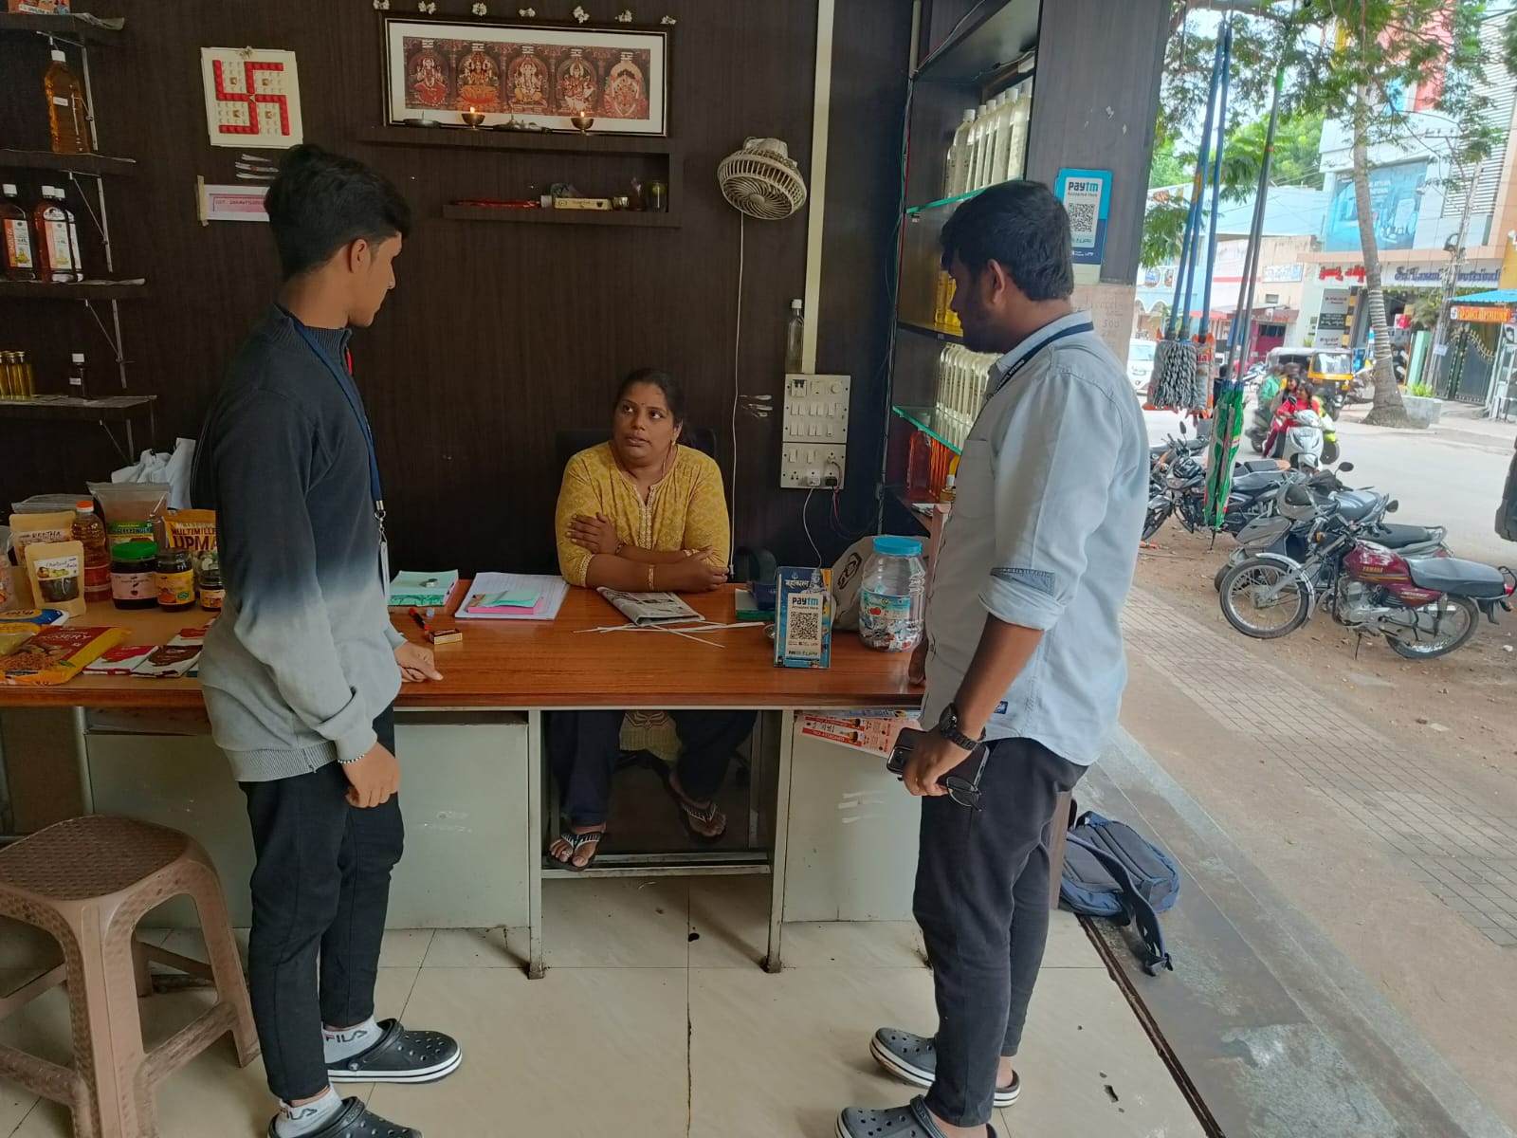
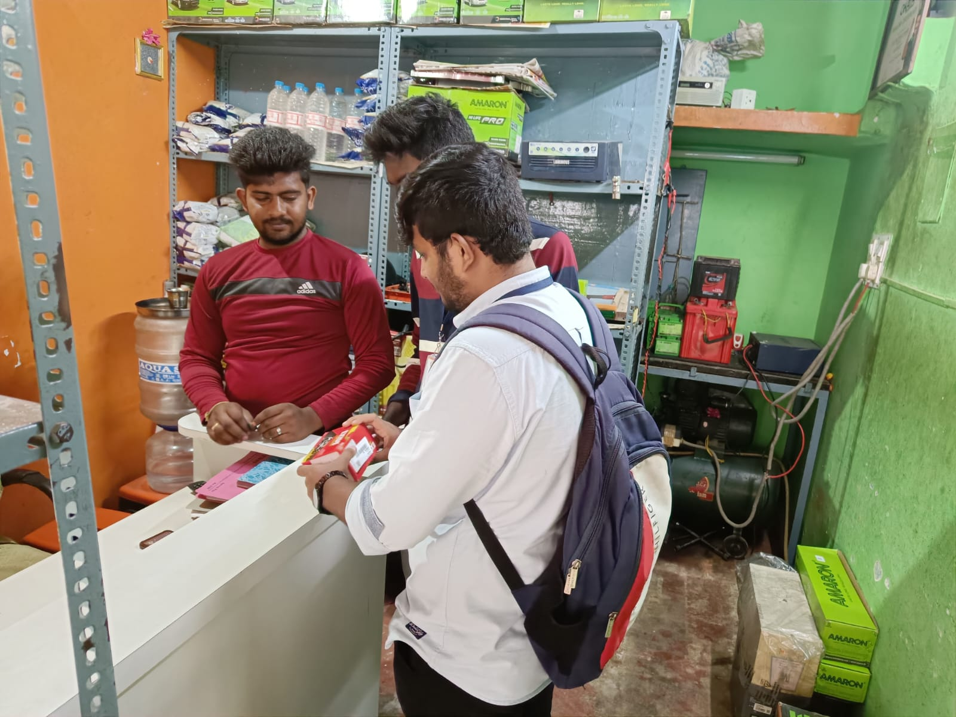
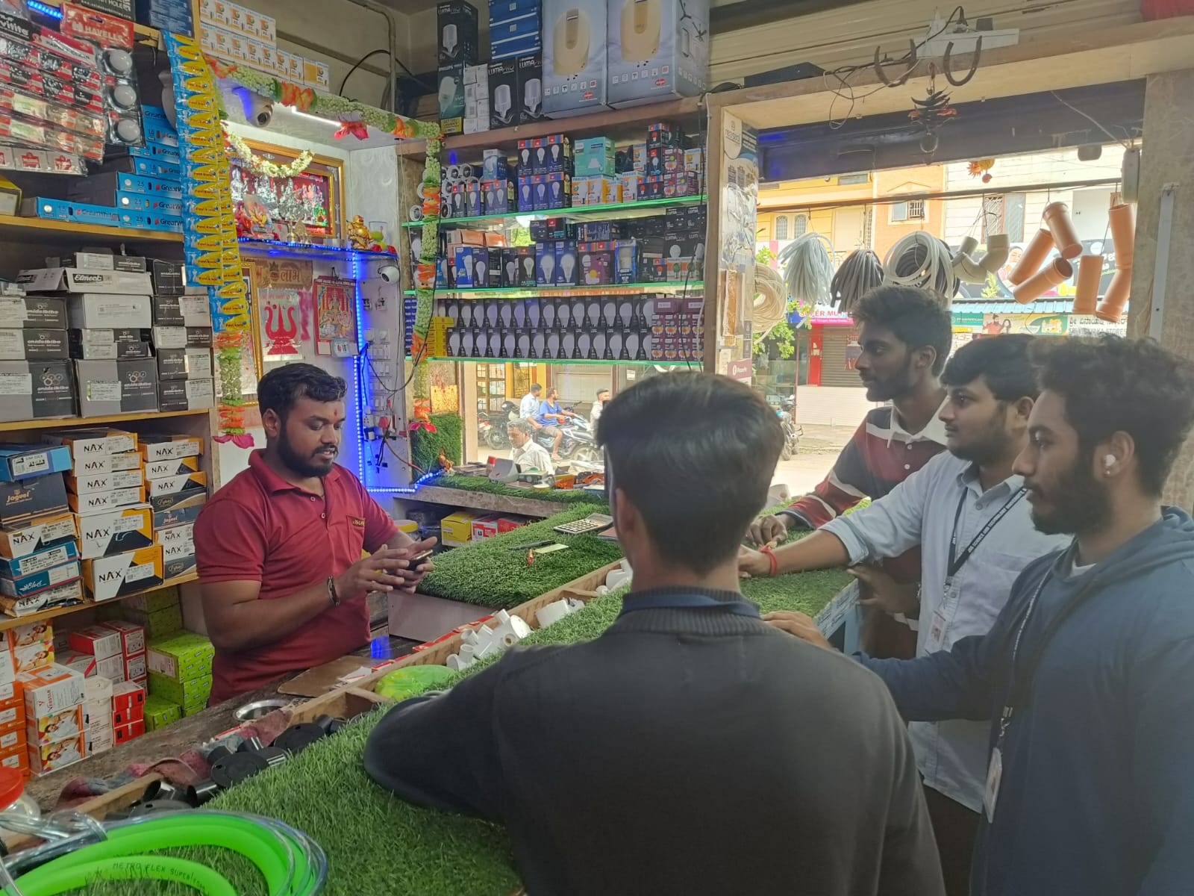

Analyse Business System(using External software)
Define Requirements
Design Goods Stock System
Design CRM Software
Start
Deploy System
Test and Debug
Implement System
End

Slide 8
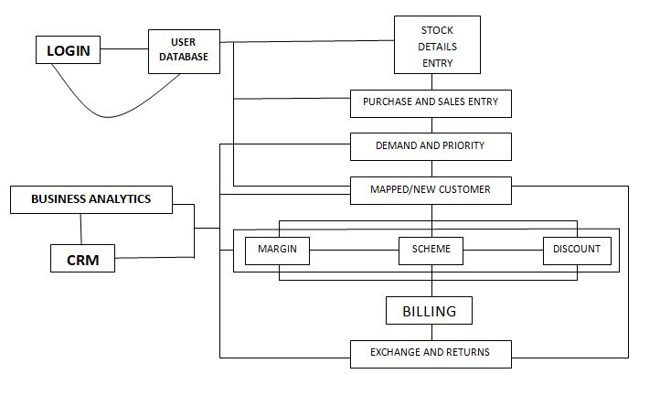
Goods Stock Management Software Outline

Slide 9
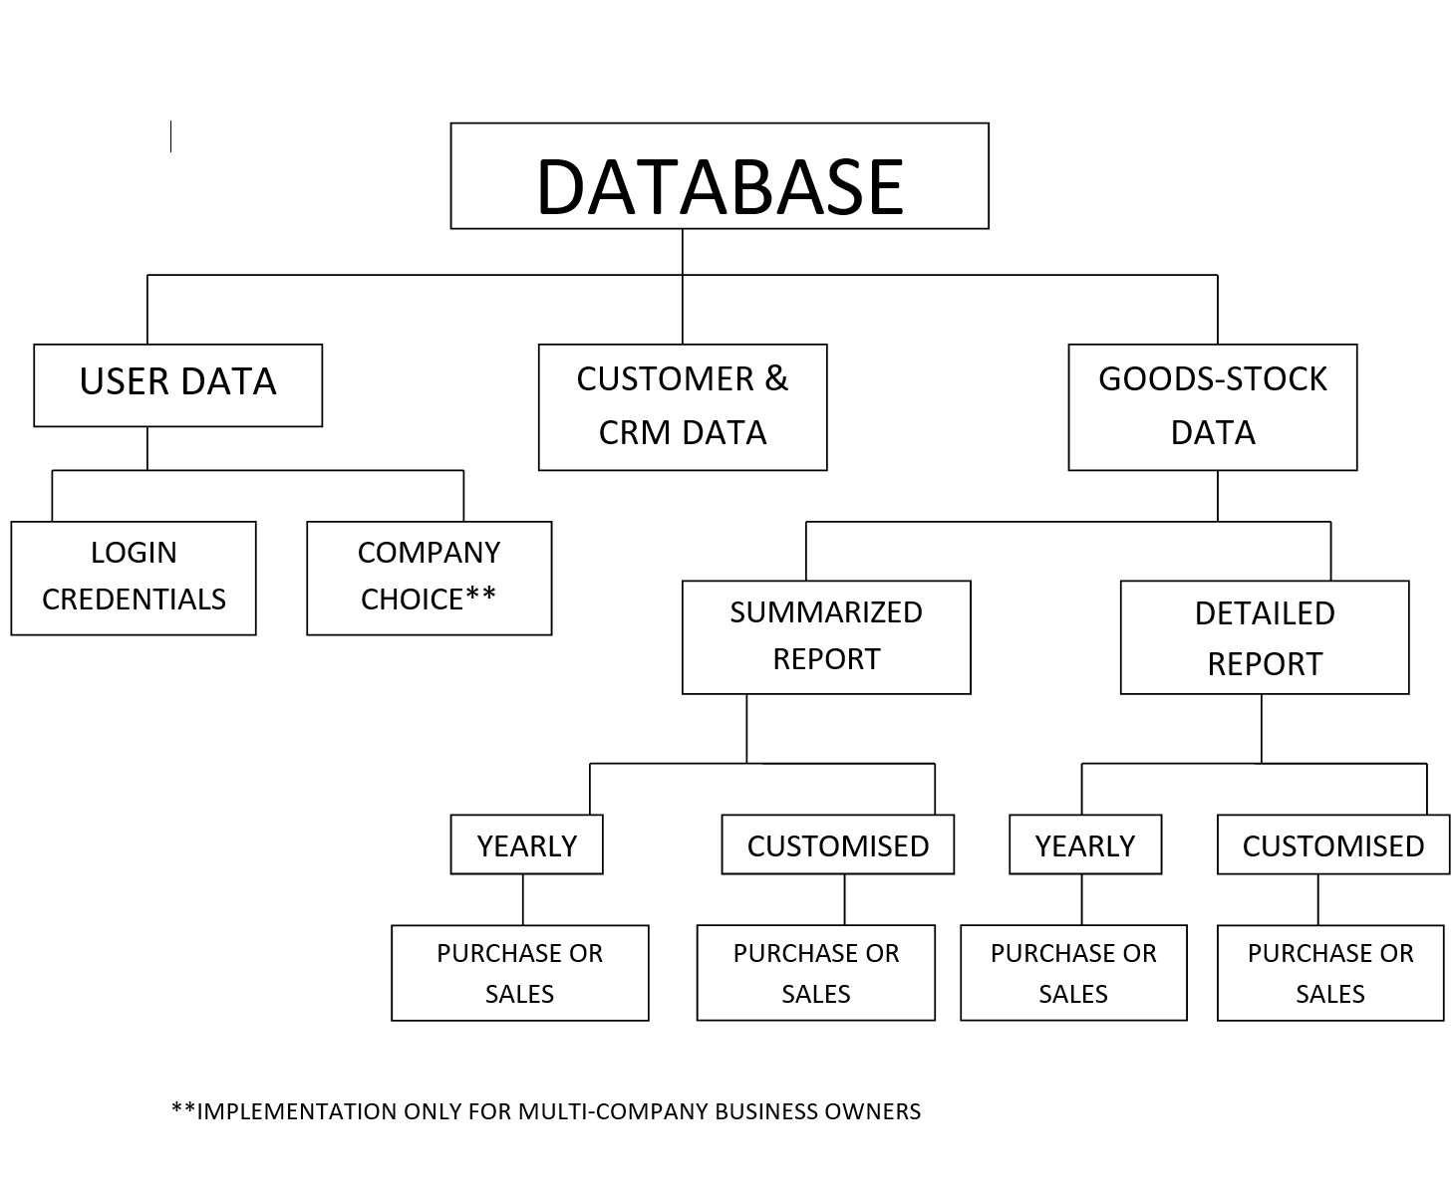
Software Outline
Customer & CRM Data
Business Analytics
Goods Stock Data

Slide 10
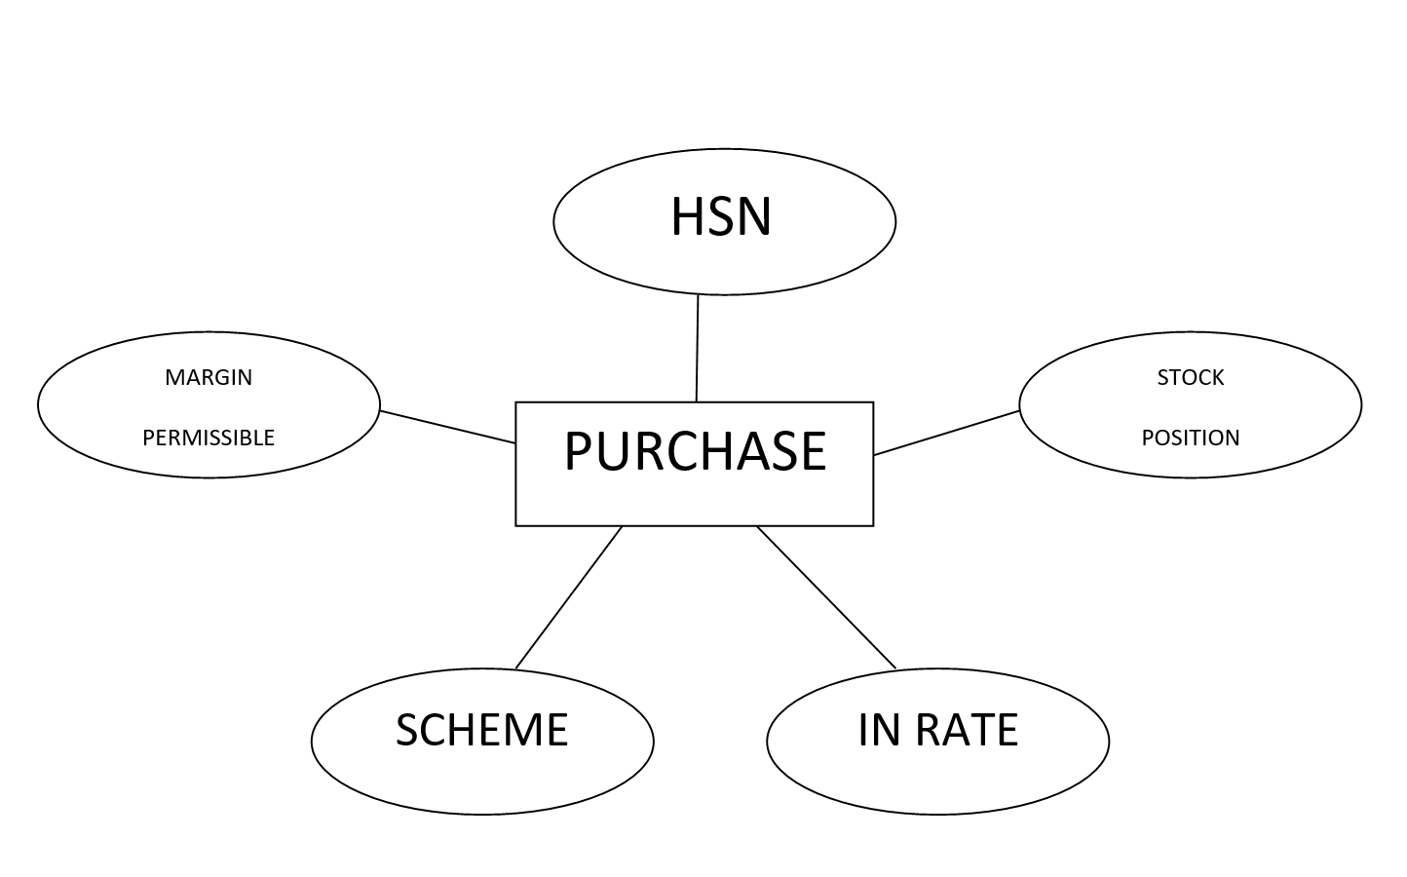
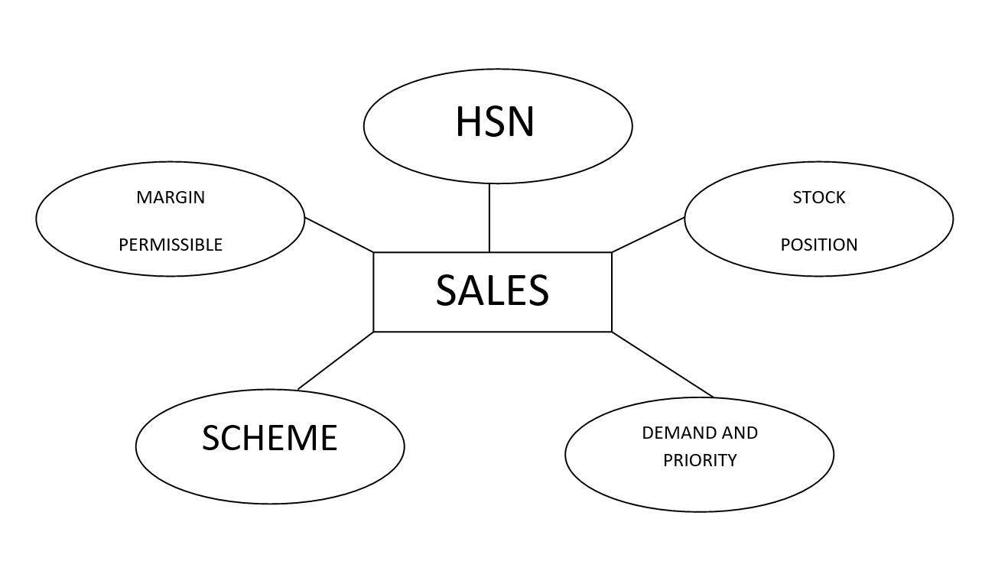

Slide 11
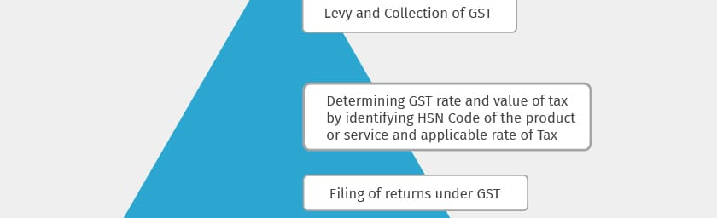
HSN Model
HS Code which is known as HSN Code in India was developed by World Customs Organization (WCO) as a standardised system that classifies goods all over the world in a systematic manner. In India, HSN Code has 4, 6 & 8-digit uniform codes that classify more than 5000 products and are accepted worldwide.

Slide 12
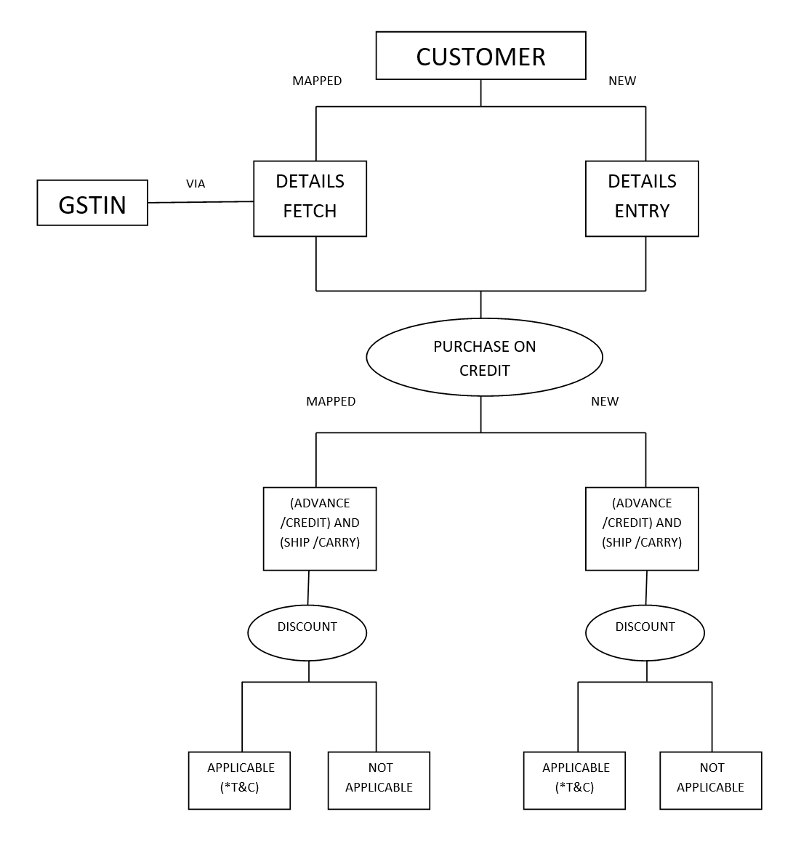

Slide 13
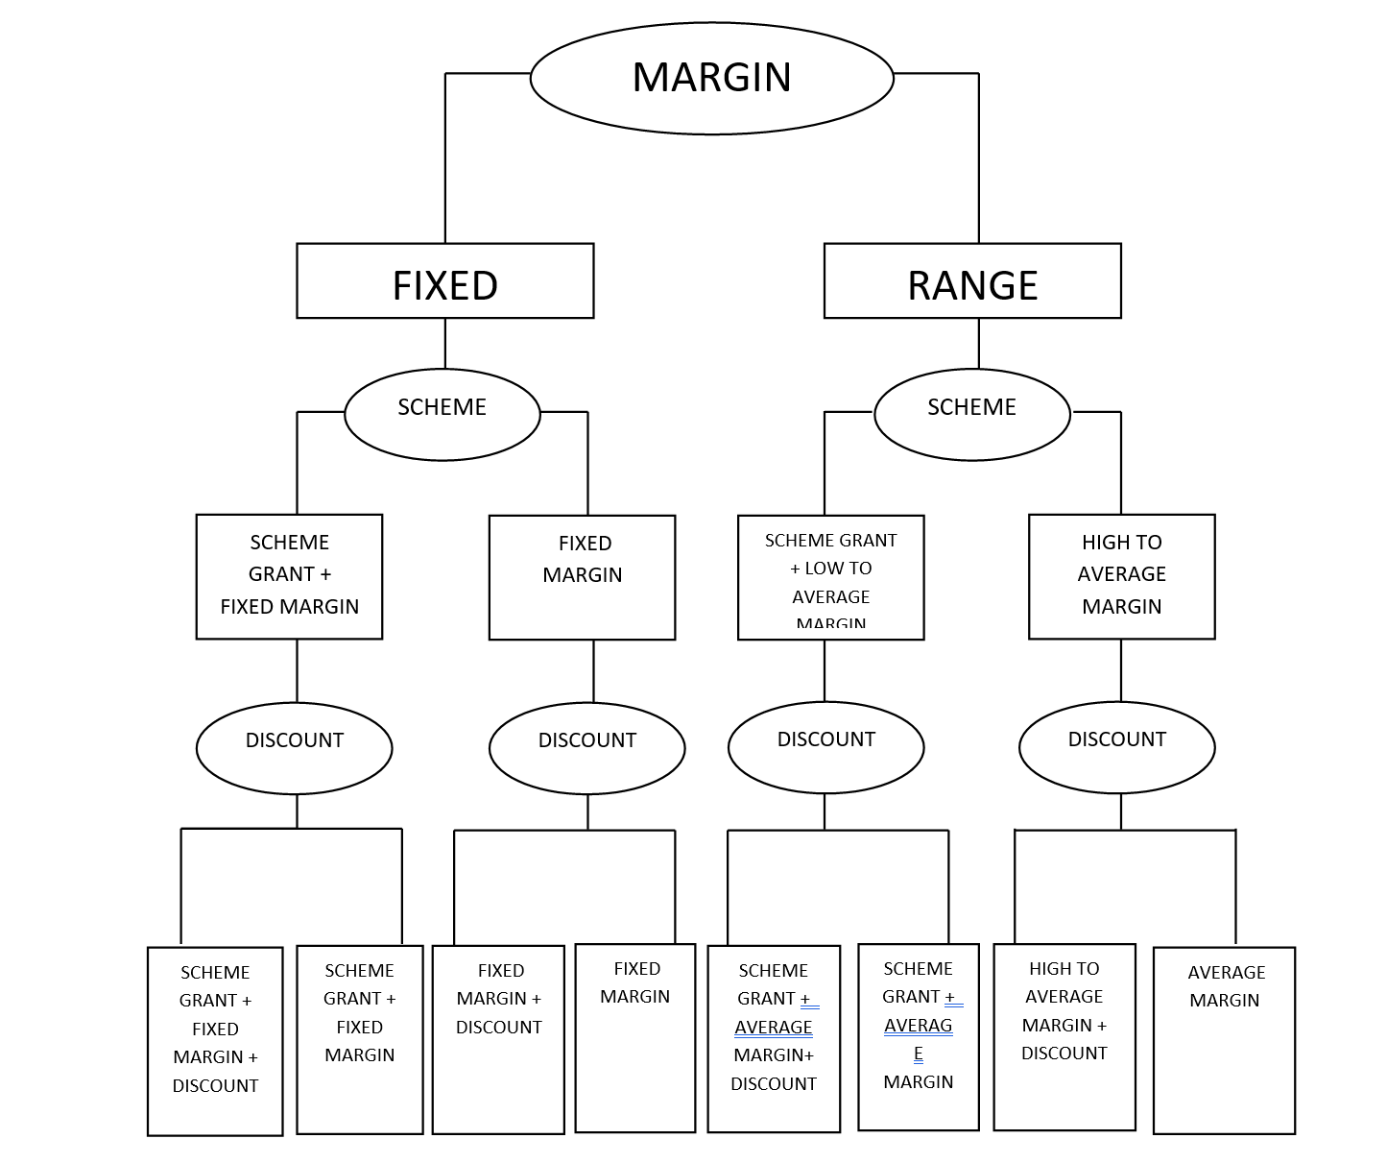

Slide 14
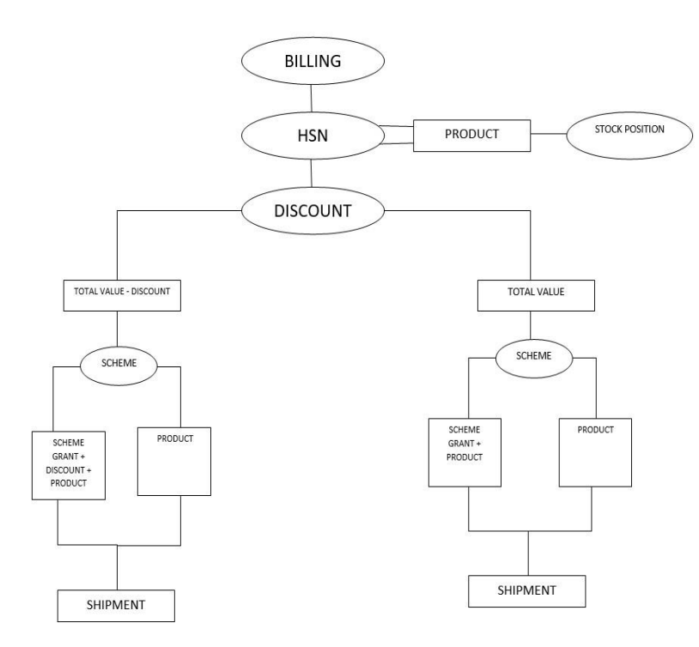

Slide 15
Customer Relationship Management
Customer login
Customer login
Customers Problems and Issues
Match Customer Info with database’ customer’s data
Collect customer’s rating & reviews
Collect customer’s problems and issues
Ask for any request for claims
Standard Mentioned
Keyboard Input
Make CRM report
Business Analytics
Business Analytics

Slide 16
Request for Claims
Same Order
Previous Orders
Damage
Expiry
Returns
Damage
Expiry
Returns
Return
Damage & Expiry
Amount Settlement
Replacement
Amount Settlement
Replacement
Grant
Hold

Slide 17
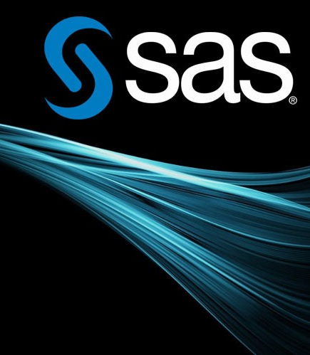
Business Analysis
The SAS API website is a platform for developers seeking to leverage SAS APIs. It provides comprehensive documentation, API references, sample code, SDKs, and community support. Developers can access resources to integrate and utilize SAS APIs effectively in their applications and systems.
SAS Analytics API: Developer.sas.com/apis/rest/v3.5/
Git HUB : github.com/sassoftware/restaf

Slide 18


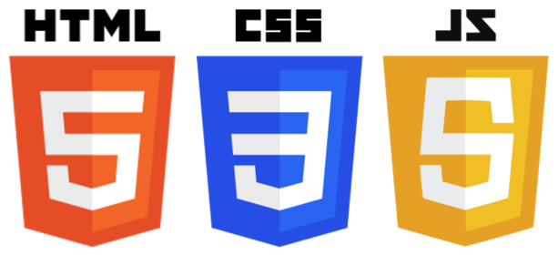
Non-Functional Requirement Description & Technical Environment
Non Functional Requirement:
Scalability and performance
Reliability
Security
Usability
Interoperability
Technical Environment:
Operating Systems: Windows or Android
Data Base Management: SQL
Programming Language: Java and Kotlin(for android)
HTML , CSS, JS (for web component required for CRM)

Slide 19
Case study report

Slide 20

Conclusion
In conclusion, we have seen that effective goods stock management and business analysis are crucial for the success of any business. By using customer relationship management software, businesses can not only manage their goods stock more efficiently but also gain valuable insights into customer behavior and market trends.
The benefits of using customer relationship management software for goods stock management and business analysis are clear - improved efficiency, increased profitability, and a better understanding of customer needs. We urge you to consider implementing this software in your own business and experience the benefits for yourself.

Slide 21

THANK YOU

